Slide 1









Slide 2
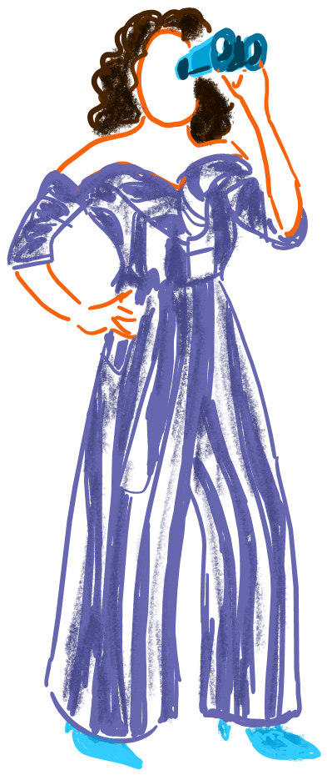

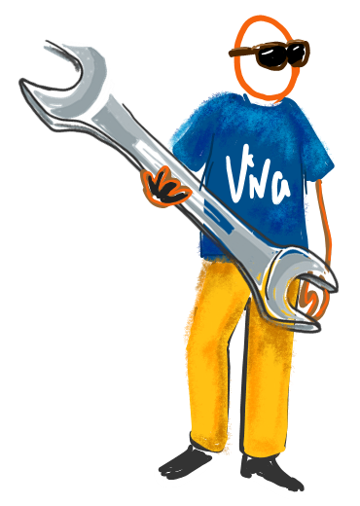

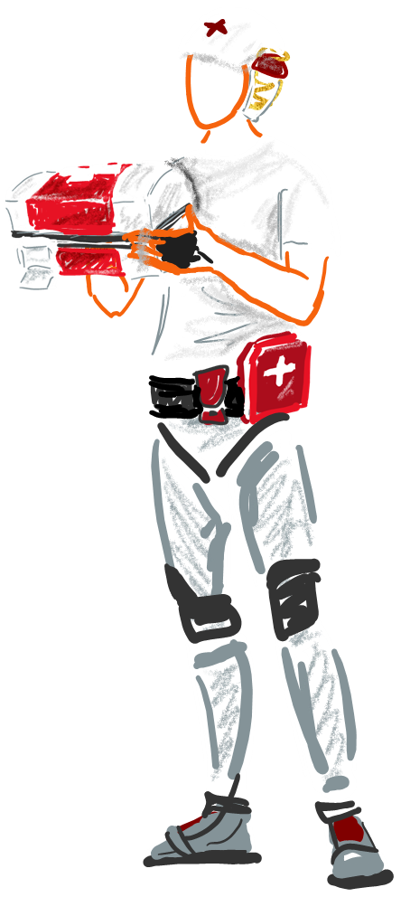



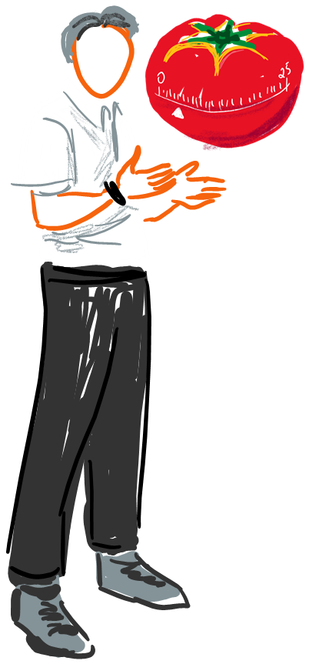





Slide 3

Viva Learning: Distributing knowledge with the help of your own videos

Slide 4


Slide 5


Slide 6
Agenda
Viva Learning: Distributing knowledge with the help of your own videos

Slide 7
Viva Learning
Distributing knowledge with the help of your own videos
The Speaker 🧑‍🦱
Types of Content🤔
Who work the Speaker? What are there Topics?
What types of content are hosted?
Topic Knowledge📚
Benefits for companies 💡
What does mean Knowledge and why it is important?
What are the benefits to integrate viva learnings as learningcenter?
Challenge around the Topic
Live Demo 🔍
Let`s Rock the show!
What is the biggest challenge for a company with regard to knowledge-management?

Slide 8
The Speaker🧑‍🦱
Viva Learning: Distributing knowledge with the help of your own videos

Slide 9





Viva Learning
Distributing knowledge with the help of your own videos
💡Follow me!💡

Slide 10





Viva Learning
Distributing knowledge with the help of your own videos
#CommunityRocks

Slide 11
The topic “knowledge”
Viva Learning: Distributing knowledge with the help of your own videos

Slide 12
Viva Learning
Distributing knowledge with the help of your own videos
Knowledge
The term "knowledge" generally refers to the understanding, information, and expertise that a person possesses about certain facts, concepts, theories, or experiences. It is the result of learning and information processing.

Slide 13
Viva Learning
Distributing knowledge with the help of your own videos
The employees and there Knowledge are important
„ When you stop getting better, you stop being good.“ (Philip Rosenthal) 🤔
Companies are only as good as their employees and benefit from their knowledge. 💪

Slide 14
Challenge around the topic “knowledge”
Viva Learning: Distributing knowledge with the help of your own videos

Slide 15
Viva Learning
Distributing knowledge with the help of your own videos
Companies
☕Underestimated topic 🎯
☕Employees do not like to host their personal knowledge 💪
☕Knowledge sharing is rudimentary 🙈

Slide 16
Viva Learning
Distributing knowledge with the help of your own videos
Employees
☕Where can I find learning content 🤔
☕What knowledge do I need? 🤔
☕Knowledge is often located in an unstructured intranet
“black hole” 😒

Slide 17
Types of knowledge content
Viva Learning: Distributing knowledge with the help of your own videos

Slide 18




Viva Learning
Distributing knowledge with the help of your own videos
Types of Content
Presentations in Form von
Text Content (Concept, Product information)
Information (Reports) in Form

Slide 19

Viva Learning
Distributing knowledge with the help of your own videos
Would you look at a 20-page document and spend your time reading it?

Slide 20
Viva Learning
Distributing knowledge with the help of your own videos
Why don't I look at the document?
☕I can't find it right away 💨
☕Loss of time for everyday tasks ⏱️
☕Different types of learners 👪
☕The content does not help 🎯
"Video is the new book"

Slide 21
Change within M365 (videos)
Viva Learning: Distributing knowledge with the help of your own videos

Slide 22



Viva Learning
Distributing knowledge with the help of your own videos

Slide 23
Benefits for companies
Viva Learning: Distributing knowledge with the help of your own videos

Slide 24
Viva Learning
Distributing knowledge with the help of your own videos
Benefits
Distribute your knowledge in the company
Videos - slimmed down to the essentials
💪Viva Learning available as a free version 💪

Slide 25
Live Demo
Viva Learning: Distributing knowledge with the help of your own videos

Slide 26

Viva Learning
Distributing knowledge with the help of your own videos

Slide 27



